Slide 1

Spelling Correction-2 Spelling Correction using Weighted Edit Distance and n-gram

Slide 2
Weighted Edit Distance
The weight of an operation depends on the character involved
Meant to capture OCR or keyboard error, example: m more likely to be mistyped an ‘n’ than as ‘q’.
Therefore replacing ‘m’ by ‘n’ is a smaller edit distance than by q.
This may be formulated as a probability model.
Require weight matrix as input.
Modify dynamic programming to handle weight.

Slide 3
Using Edit Distance
Given Query, first enumerate all character sequence within a preset (weighted) edit distance (e.g. z).
Intersect this set with list of “correct” words.
Show term you found to user as suggestions
Alternatively
We can lookup all primitive correction in our inverted index and return all document show.
We can run with a single most likely correction
The alternatively disempower the user, but save a round of interaction with the user

Slide 4
K-gram index
A k-gram index maps a k-gram to a postings list of all possible vocabulary terms that contain it. The figure below shows the k-gram postings list corresponding to the bigram “ur”.

Slide 5
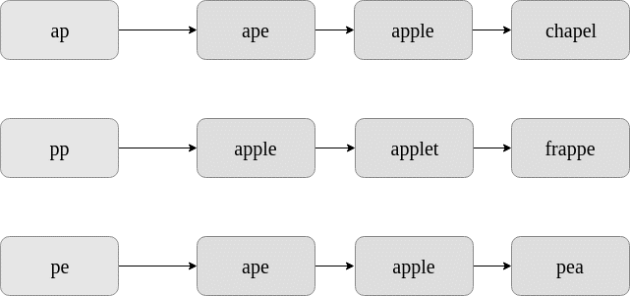
Spelling Correction
Consider the misspelt word: “appe”.

Slide 6
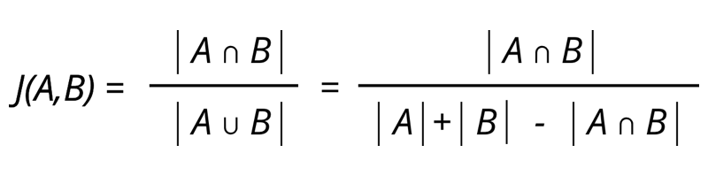
Spelling Correction
To find the k-gram overlap between two postings list, we use the Jaccard coefficient.
A and B are two sets (postings lists), A for the misspelt word and B for the corrected word.

Slide 7
Contd..
Some candidate terms for spelling correction, namely “ape” and “apple”.
“ape”
scan through the postings lists of all bigrams of “appe” and count the instances where “ape” appears.
In the first postings list, “ape” appears 1 time. In the second postings list, “ape” appears 0 times. In the third postings list, “ape” appears 1 time.
Therefore, A intersection B=2
The no. of bigrams in “appe” is 3, and the no. of bigrams in “ape” is 2.
Therefore, A union B=3+2-2=3
J(A,B)=2/3=0.67

Slide 8
Contd..
“apple”
A intersection B=3, the number of bigram in “appe” is 3 and the number of bigram in apple is 4. So A union B=3+4-3=4
J(A,B)=3/4=0.75
This suggests that “apple” is a more plausible correction. Practically, this method is used to filter out unlikely corrections.

Slide 9
Steps to Follow
The steps involved for spelling correction are:
Find the k-grams of the misspelled word.
For each k-gram, linearly scan through the postings list in the k-gram index.
Find k-gram overlaps after having linearly scanned the lists (no extra time complexity because we are finding the Jaccard coefficient).
Return the terms with the maximum k-gram overlaps.

Slide 10
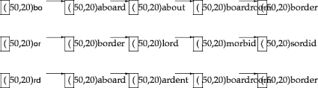
Practice
Query is for bord

Slide 11
boardroom and bord
Jaccard coefficient =2/8+3-2=2/9
bord and board?
bord and aboard?
bord and border?

